Slide 1
CS634 Data Mining Final Term Paper Proposal
Driver Yawning Detection Based on Subtle
Facial Action Recognition

Slide 2
Introduction
An investigation conducted by the National Highway Traffic Safety Administration (NHTSA) showed that more than one in three respondents confessed to have experienced fatigue while driving.
Every year about 100,000 police reported crashes involve drowsy driving. These crashes result in more than 1550 fatalities and 71,000 injuries.^{[1]}
Research shows that driver fatigue lead to more than 22% of traffic accidents and it’s six times more likely to cause collision or near collision than normal driving.
Drowsy driving is impaired driving. Drivers not only put themselves at risk but also others.

Slide 3
Statistics explains why over the past decades lot of researches have been performed to recognize driver fatigue and improve road safety.
Frequent yawning is one of the prominent signs of fatigue that can lead to drowsy driving.
The accurate and robust detection of yawning is difficult due to the complicated facial actions and expressions of drivers in the real driving environment.
In this paper, a novel approach to detect yawning based on subtle facial action recognition is proposed. A 3D convolution network with Low time sampling and bidirectional LSTM networks for spatial temporal feature extraction followed by softmax for classification.

Slide 4
Existing Models
Existing yawning detection methods can be classified into three categories
Appearance based method detects yawning through variations in the aspect ratio of the mouth profile.
Critical value of the aspect ratio was determined using a series of experiments and if aspect ratio of a particular sample falls below the threshold its characterized as yawning.
Advantage : Low computation cost
Limitations:
Difficult to determine when tester’s facial feature points when the head rotated at certain angle
calculation of threshold is sensitive to external factors and the anti-noise capability is poor
camera jitter may result in missed or false detection.

Slide 5
Handcraft feature based method evaluated facial representation based on statistical local features. Various techniques were used.
The AdaBoost algorithm was adopted to learn the most discriminating fatigue facial (Local Binary Pattern) LBP feature from a large pool of LBP features
Histogram values are obtained from the vertical projection of the lower part of the face. The presence of yawning was indicated by a black blob in the mouth region of the binary image
Yawning detection framework based on mouth inner contour corner detection and curve fitting of corner points
Another proposed method was based on the study of the spatiotemporal descriptors of a nonstationary and nonlinear signal. They used the strength of the signal to determine if the testers were in the yawning state.
Advantages: Robustness of the detection algorithm to various environments and improved accuracy.
Limitations:
Not robust to various light conditions
calculation of threshold is sensitive to external factors and the anti-noise capability is poor
camera jitter may result in missed or false detection.

Slide 6
Deep Learning-Based Methods – Uses 2D convolutional network to extract facial expression features for classification and inputted a face image directly into the network.
Advantage: Improved classification accuracy
Limitation: Single static image-based deep learning methods perform efficiently in classification but have poor robustness and reliability compared with traditional methods.
Also yawning is a continuous action, single static images for classification
loses important temporal information.

Slide 7
Proposed Model
A progressive approach to yawning detection based on video is proposed in this paper to solve this problem single static images.
The proposed model shows improved computation and reduced false positives.
In order to avoid a fatal accident, yawning has to be recognized in real time and model should be simple and efficient in observing subtle facial actions.
Subtle facial actions are characterized by a small variation in action between contiguous frames compared with body actions.
The proposed method is divided into three main parts:
Data-preprocessing module
Key frame selection module
Subtle facial action classification module

Slide 8
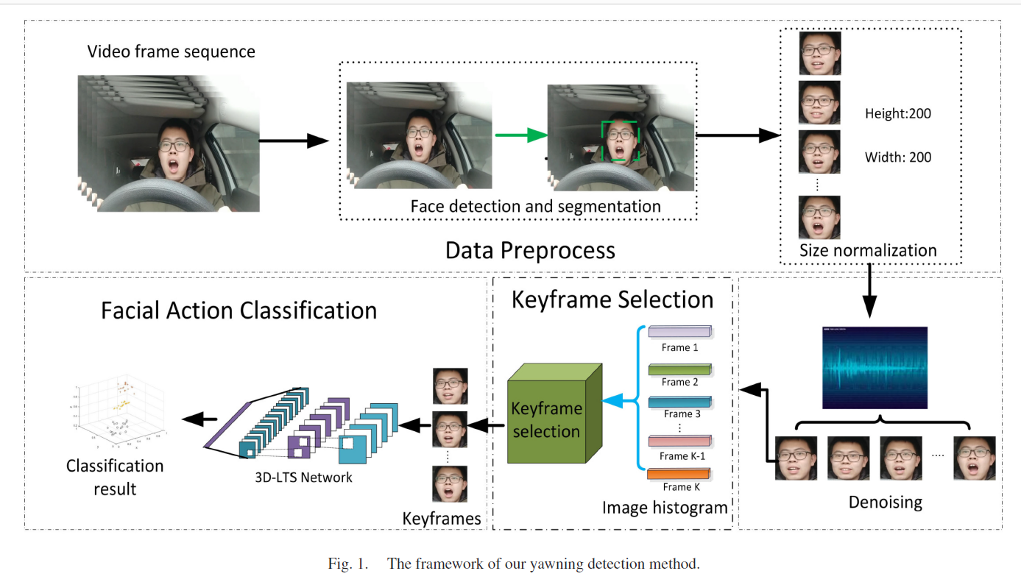

Slide 9
Data Preprocessing
This part is further divided into:
face detection and segmentation
image size normalization and de-noising
The Viola–Jones algorithm is used to detect and segment the face area to reduce the influence of background appearance information.
The size of the consecutive frames should be uniform after segmentation
The uniformed consecutive frames are then de-noised via a fast median filtering algorithm(MAF).
The processed frames are finally inputted to the next part.

Slide 10
Key Frame Selection Algorithm
Key frame selection is performed by inputting original video frames
Key frames are selected through histogram distance and outlier detection to eliminate redundant frames
Selected key frames are then inputted to a subtle facial action recognition network (3D-LTS)
Challenges posed by existing algorithm
Existing algorithm used pyramid motion feature of each frame selected by AdaBoost algorithm. Benchmarking tools were used and keyframes were selected using clustering.
Clustering posed the disadvantage of complicated calculation
A new key frame selection algorithm is designed in this paper to achieve these characteristics.

Slide 11
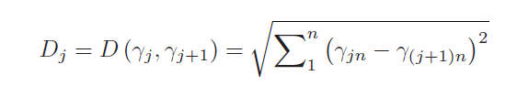
Proposed Key frame Selection Algorithm
The proposed algorithm is used to extract a set of keyframesK = {Ki, i = 1, . . . , M}from a set of video frames F = {Fj, j = 1, . . . , N}, where M is the number of key frames selected from the original frames, and Nis the number of original frames.
First, the color histograms of each frame from videos are calculated to extract candidate key frames.
These candidate key frames are then filtered on the basis of the median absolute deviation (MAD) of their root-mean-square error (RMSE) and Euclidean distance (ED)
The distance between the color histograms (γj and γj+1) of two consecutive frames is calculated using ED
After calculation, a set D comprising the distances between Fj and Fj+1is obtained
A distance threshold TD must be determined for the selection of key frames to represent the average distance between adjacent frames. When the distance between the adjacent frames is larger than this threshold, the content of the two pictures can be considered relatively different and used as a candidate key frame
Here, n is the dimension of Image color histogram

Slide 12
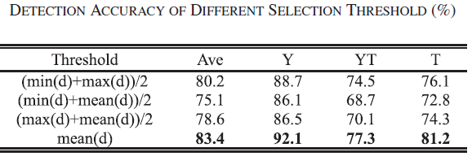
Four commonly used threshold calculation methods
From the table below, d is the distance set, YT is yawning while talking, Y is yawning and T is talking.
A high accuracy indicates the effectiveness of the selected key frame. The results show that using average distance threshold achieves the best results.

Slide 13
After the distance threshold TD is computed, Fj is added to set K( candidate set)
These candidate frames are filtered by removing those similar to their immediate frames which is computed using image distances – ED and RMSE.
MAD is used in the proposed algorithm to detect outliers
Two consecutive key frames are denoted as Ki,i+1. After the two distance vectors RMSE and ED are obtained for all Ki,i+1,the MAD for each vector denoted as α = MAD(RMSE) and β = MAD(ED) is computed.
Pairs with RMSE less than α or ED less than β are considered similar, and frame Ki is removed from candidate key frames.
These frames are then inputted to Subtle facial action classification module -3D convolution using LTS.
(Refer Fig2)

Slide 14
Fig 2: The key Frame selection Algorithm Framework

Slide 15
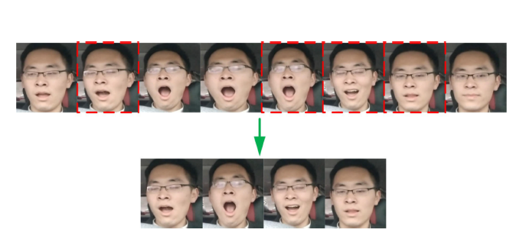
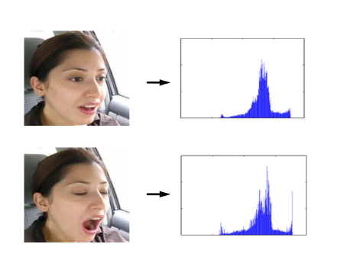
Fig 4: KeyFrames Selected by proposed algorithm
Fig 5: Histograms corresponding to two facial expressions differ

Slide 16
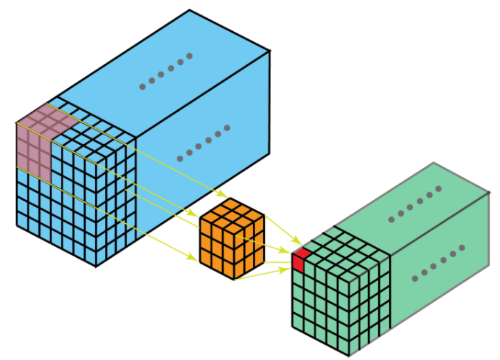
3D convolution Network
A 3D Convolution is a type of convolution where the kernel slides in 3 dimensions as opposed to 2 dimensions with 2D convolutions. ^{[3]}
Why use 3D Convolution Networks?
3D CNN's are used when you want to extract features in 3 Dimensions or establish a relationship between 3 dimensions.
Three main types of layers are used to build CNN architecture: Convolutional Layer, Pooling Layer, and Fully-Connected Layer.
3D convolution networks have shown faster computation and higher accuracy
3D ConvNet has the ability to model and preserve temporal information better due to 3D convolution and 3D pooling operations.
3D ConvNets are efficient and simple to use
Fig 3 Kernel sliding on 3D data

Slide 17
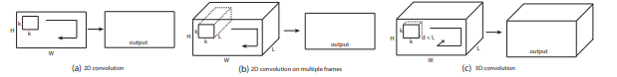
Subtle action Recognition Network
Why use 3D Convolution Networks? (Continuation) ^{[2]}
Fig a) Applying 2D convolution on an image results in an image. b) Applying 2D convolution on a video volume also results in an image. c) Applying 3D convolution on a video volume results in another volume, preserving temporal information of the input signal.

Slide 18
3D LTS Model
3D-LTS can be divided into two parts:
Short-term spatiotemporal feature extraction using LTS
Long-term sequence features using Bidirectional LSTM
3D LTS model capture spatiotemporal feature information as well as analyze long term temporal feature sequences.
Network utilizes LTS characteristic for subtle action recognition
Architecture includes the following: ( Refer Fig):
5 Convolution Layers
5 Max Pooling layers
2 Bidirectional LSTM layers
1 Fully Connected layer
1 Softmax Layer

Slide 19
Overview of the model
Input to Network: Image cube comprising of 8 frames segmented from the video sequence
Keyframes are extracted based on the keyframe algorithm and transmitted to 3D LTS Model to obtain spatiotemporal features.
Softmax layer can classify the video sequence label and recognize subtle facial actions.
Delving deeper into the working of 3D LTS
Inputs are 3D tensors which has dimensions – temporal length, height and width
Using empirical calculations we find that best kernel size is 3*3*3

Slide 20
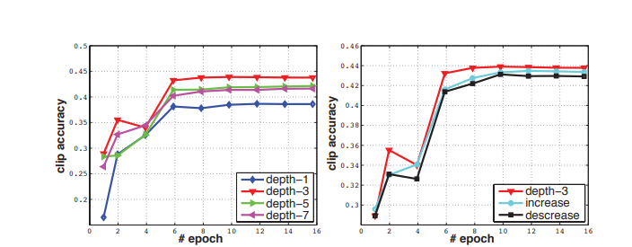
Kernel value selection
Fig: Action recognition clip accuracy on UCF101 test split-1 of different kernel temporal depth settings. 2D ConvNet performs worst and 3D ConvNet with 3 × 3 × 3 kernels performs best among the experimented nets.^{[2]}
3D convolutions in the convolution stages of convolutional networks can
compute features from spatial and temporal dimensions

Slide 21
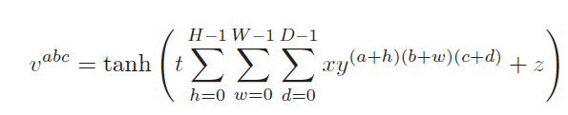
At each feature map of any single layer, the value at position (a, b, c) is given by the following, D is the size of the 3D kernel along the temporal dimension.
Thus, the action information encoded in multiple adjacent frames is captured.
3D-LTS also generates multiple channels of information from the input frames, and the final feature representation combines information from all channels.

Slide 22
Architecture continuation
The 1 × 2 × 2 max pooling is applied after conv1 and conv2, the 1 × 4 × 4 max pooling is applied after conv3, and the 2 × 2 × 2 max pooling is applied after conv4 and conv5
After multiple layers of convolution and pooling, the eight input frames are converted into a feature vector to capture the facial action information in the input frames.
The feature vector is fed into a structure of two LSTM layers running in two directions (bidirectional LSTM).
The two LSTM layers are then followed by a fully connected layer with 1024 outputs for mapping features.
The scores for the action-specific features are obtained after the fully connected and SoftMax layer

Slide 23
Short-term spatiotemporal feature extraction using LTS
3D LTS model extract spatiotemporal features from inputted video sequence
Why Pooling?
The pooling operation aims to ignore changes in relative positions, such as tilt and rotation.
Thus, the accuracy is improved, the dimensions of the feature map are reduced, and overfitting can be avoided.
Extracted features are highly representative of the shallow temporal features

Slide 24
What is LTS?
LTS is Low Time Sampling.
In the proposed model, feature maps generated by the first three convolutions are not down sampled - time dimension of the first three layers of the max pooling layer is 1. This condition is called LTS.

Slide 25
Long-term sequence features using Bidirectional LSTM
With the previous feature extraction operation, the short-term facial spatiotemporal features for specific length are extracted.
For an entire facial action video, the long-term facial spatiotemporal features of the video can represent this video completely.
Bidirectional LSTM comprises of 6 shared weights (ω1-ω6)
In the bidirectional LSTM unit, the backward and forward layers are connected to the output layer.
The memory cell stores the past contexts, and the input and output gates allow the cell to store contexts for a long period.
The special design of bidirectional LSTM allows the capturing of long-range dependencies, which often occur in image-based sequences.

Slide 26
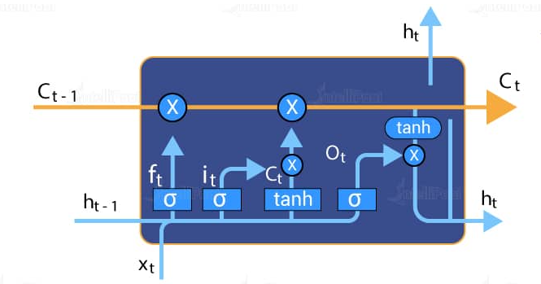
What is LSTM?
It an artificial recurrent neural network (RNN) architecture used in Deep learning.
Recurrent Neural Network(RNN) are a type of Neural Network where the output from previous step are fed as input to the current step. The main and most important feature of RNN is Hidden state, which remembers some information about a sequence. ^{[5]}
A common LSTM unit is composed of a cell, an input gate, an output gate and a forget gate. The cell remembers values over arbitrary time intervals and the three gates regulate the flow of information into and out of the cell.

Slide 27
What is bidirectional LSTM
These are like an upgrade over LSTMs.
In bidirectional LSTMs, each training sequence is presented forward and backward as to separate recurrent nets. Both sequences are connected to the same output layer.
Bidirectional LSTMs have complete information about every point in a given sequence, everything before and after it.
This helps yo preserve information from both past and future.

Slide 28
Example: Bidirectional LSTM
If we have to predict the next word of the sentence “ The boys went to…”
With bidirectional LSTM you will be able to see the information further-
Forwards LSTM: The boys went to ....
Backward LSTM: ….and then they got fever playing in pool for long.
We can see that combining information from past and future we can predict the next word as “pool”.
Bidirectional LSTMs gives better predictions as they can understand context well, and hence used in out proposed model.

Slide 29
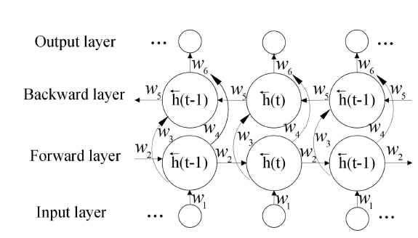
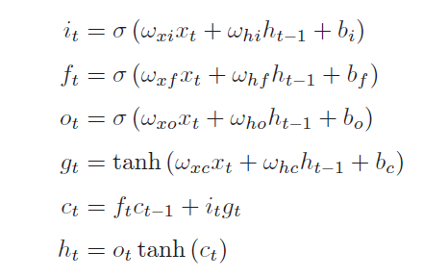
Fig: The structure of bidirectional LSTM cell used in this paper
i_{t}, f_{t}, o_{t}, h_{t} and c_{t} are the input gate, forget gate, output gate, hidden state and memory cell activation vectors

Slide 30
More about Bidirectional LSTM Cell
σ is the definition of a function, and tanh is the hyperbolic tangent function
The forget gate f_{t} decides clearance of information from the memory cell ct
The input gate i_{t} decides when new information should be incorporated into the memory
The tanh layer g_{t} generates a candidate set of values that will be added to the memory cell with the approval of the input gate
the memory cell ct is updated on the basis of the input gate i_{t}, forget gate f_{t}, and new candidate values g_{t}.
the output gate ot controls the status and memory information of the hidden state
The hidden state is represented as a product between a function of the memory cell state and the output gate

Slide 31
Fully Connected Network (FC)
Fully connected layers connect every neuron in one layer to every neuron in another layer
Softmax
An activation function used multi-classification in logistic regression model
The softmax function can be used in a classifier when the classes are mutually exclusive.

Slide 32
Fig 3: Structure of 3D LTS Network

Slide 33
Experiments – Caffe deep learning
Caffe provides a complete toolkit for training, testing, finetuning, and deploying models, with well-documented examples for all of these tasks.
Features
Modularity
Test coverage
Python and MATLAB bindings
Pre-trained reference models

Slide 34
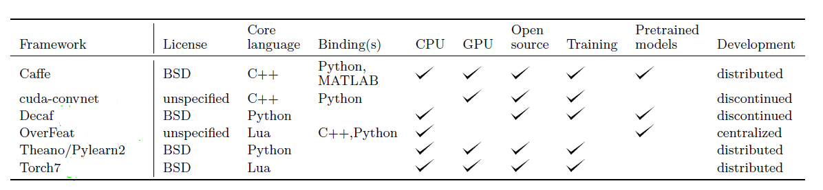
Advantages:
Caffe provides a complete set of layer : convolution, pooling, inner products, nonlinearities like rectifed linear and logistic, local response normalization, elementwise operations, and losses like softmax and hinge.
Coding custom layers requires minimal effort.
Comparison of popular deep learning frameworks

Slide 35
Datasets
Two datasets are used here:
yawDDR
Multi-Facial Action Yawning Dataset (Self Collected)
YawDDR
Contains a series of action videos collected from volunteers of different genders, ages, countries, and ethnicities.
Videos are shot in daylight/illuminated conditions
Contains 3 or 4 videos of each driver with different mouth actions like talking, yawning and yawning while talking
Length of videos is 8 seconds

Slide 36
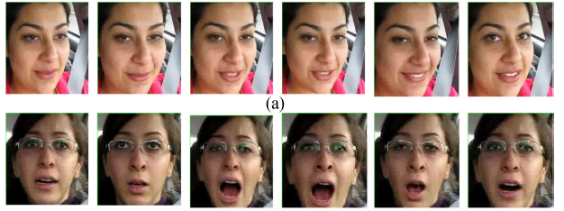
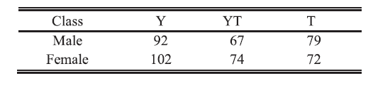
Image sequences of two types of action in YawDDR dataset (a)
Talking. (b) Yawning.
Number of sequences in YawDDR dataset

Slide 37
MFAY
Dataset was developed to include more facial actions than what publicly available datasets could provide.
Mimics external conditions of YawDDR dataset.
Facial actions include: talking (T), yawning while talking (YT), yawning (Y),
singing (S), yawning while singing (YS), and shouting (ST).
Length of each image sequence is 5 seconds.

Slide 38
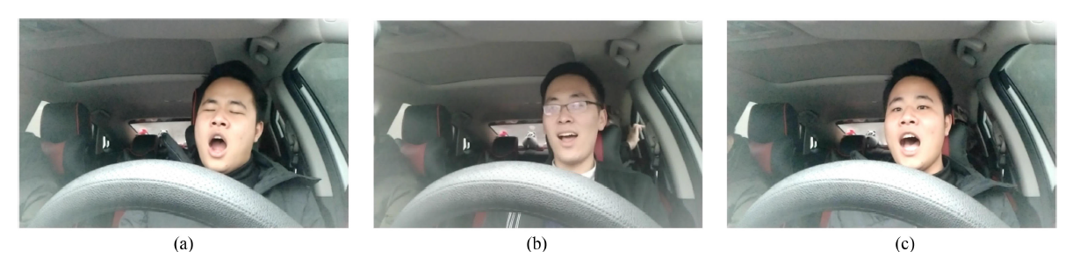
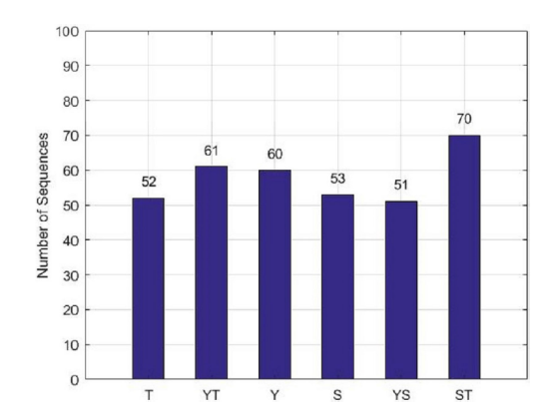
(a) Yawning (b) Singing (c)Shouting
Number of video sequences in MFAY dataset

Slide 39
Conclusion
Existing yawning detection methods are based on static images and lack temporal features.
They are inefficient in situations such as tilted head and expressions with same deformation as yawning.
The proposed model is created in a way to overcome the challenges posed by the existing model.
Firstly, it proposes an improved key frame algorithm that has reduced computation costs and improved keyframe selection.
Secondly, utilizing 3D convolution network with LTS and LSTM has improved the prediction by considering short and long term video sequences to gain context of the facial action.
This method is extensively tested on self collected as well as YawDDR dataset.

Slide 40
Future Enhancement
In future, image preprocessing methods can be further improved to deal with images with low resolution and blurry images.
Keyframe algorithm can also be further improved to handle with diverse illumination conditions.

Slide 41
References
[1] https://www.nsc.org/road-safety/safety-topics/fatigued-driving
[2] D. Tran, L. Bourdev, R. Fergus, L. Torresani, and M. Paluri, “Learning spatiotemporal features with 3D convolutional networks,” in Proc. IEEE Int. Conf. Comput. Visin., Santiago, 2015, pp. 4489–4497
[3] https://ai.stackexchange.com/questions/13692/when-should-i-use-3d-convolution
[4] https://en.wikipedia.org/wiki/Long_short-term_memory
[5] https://www.geeksforgeeks.org/introduction-to-recurrent-neural-network/
[6] https://intellipaat.com/blog/what-is-lstm/
[7] https://stackoverflow.com/questions/43035827/whats-the-difference-between-a-bidirectional-lstm-and-an-lstm

Slide 42

Thank You!
Thank You

